Slide 1
BIGTECHCOMPANY
Financial Overview

Slide 2
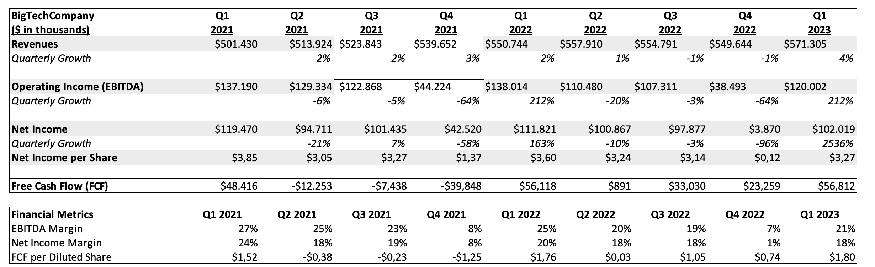
QUARTERLY PERFORMANCE

Slide 3
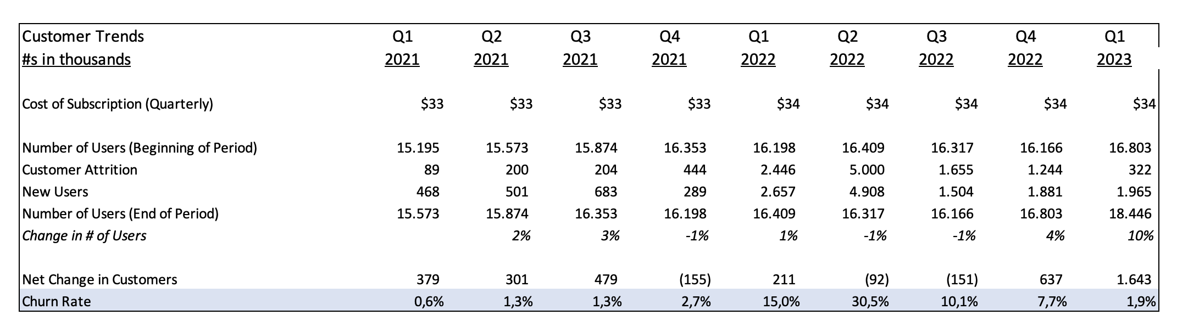
CUSTOMER TRENDS
Key Takeaways:
in the Q4 , the company declared increased price, after it the churn rate increased to a massive level; it took a lot of time to get it to the same value
due to price increase, consumer attribution started increasing at a massive scale.; also the increase of new users also increased during this time.

Slide 4
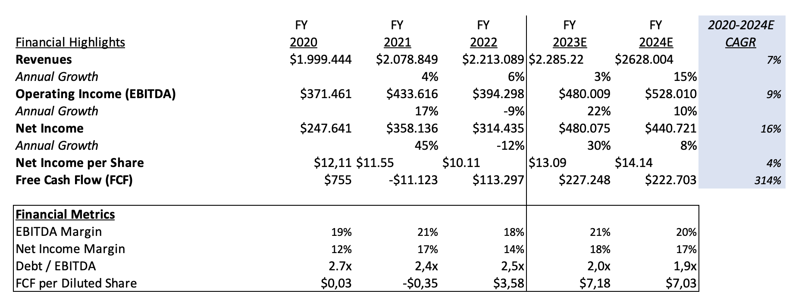
PROJECTIONS

Slide 5
CONCLUSIONS
Company Highlights
The future expected revenue trend is supposed to be increasing; future cash flow is also increasing
Debt/ebitda is also less than industry (4x) which is a positive sign.
Net income cagr is growing.
Areas of concern
4th quartile volatile expenses (increased prices on all the costs)
EBITDA is also low then industry specific 39%
Recommendation
We should ask company about increased cost in 4th quarter
If there is going to be increase in price of subscription to calculate customer attribution.
Overall it’s a good company to adjust with estimated good return in the future as well.

